Slide 1

Enhanced Tax Deduction for R&D Expenditures
“Designated Local Research Institutions”
Innovation and Technology Commission
Version: 1.9

Slide 2
“Designated Local Research Institutions”
(DLRI)

Slide 3
Designated as DLRIs
Inland Revenue Ordinance (Section 19, Schedule 45) –
  The Commissioner for Innovation and Technology (CIT) may designate any university or college located in HK, or any other institute, association, organisation or corporation located in HK that undertakes “qualifying R&D activities” in HK as a DLRI
  The CIT has designated major local universities and research institutions as DLRIs
  Other local institutions (institutes, associations, organisations or corporations) incorporated or formed under relevant Laws of HK may also apply to Innovation and Technology Commission (ITC) for designation as DLRIs

Slide 4
Designated as DLRIs (Cont’d)
  Companies engaging DLRIs to undertake “qualifying R&D activities” may claim enhanced tax deduction for the payments made
  If a “local institution” becomes a DLRI within six months after payments were made by an enterprise, the enterprise may claim enhanced tax deduction in respect of such payments
  The eligible applicant shall be an institute, association, organisation or corporation that is incorporated or formed according to relevant Laws of HK

Slide 5
Application Procedures

Slide 6
Application for Designation as DLRIs
  ITC started to accept applications for designation as DLRIs on 31 January 2019
  Application open all year round
  Details of application procedures and assessment criteria available from ITC website (https://www.itc.gov.hk/en/fund_app/dlri/dlri.html)

Slide 7
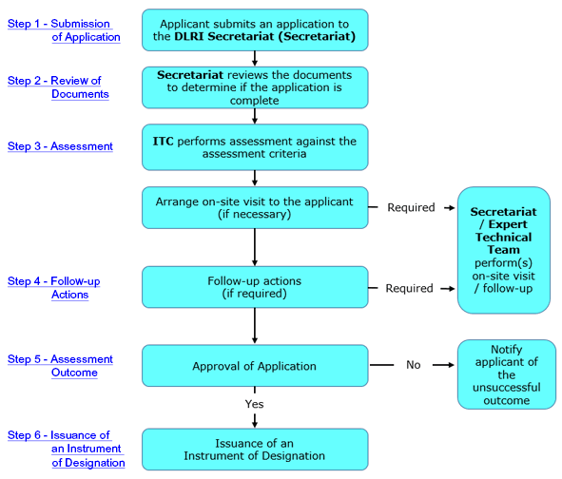
Application Procedure

Slide 8
Application Procedure (Cont’d)
  Applications shall include
    a duly completed and signed Application Form
    all the required supporting documents as listed in the checklist
    Applications can be submitted by one of the following ways:
    By Online form (through “GovHK”)
    By Email (Electronic Submission)
    By Post or In Person
    (either hard copies or electronic copies stored in electronic device)

Slide 9
Assessment of Applications

Slide 10
Assessment of Applications
  Applications will be assessed against designation criteria
  On-site inspections and interviews with the applicant’s representatives / employees may be necessary
  Expert Panel on Designation of DLRIs may be consulted

Slide 11
Expert Panel on Designation of DLRIs
Expert Panel provides advice on:
Assessment of applications
Revocation of the designation status of DLRIs
  Monitoring and improvement of the DLRI designation mechanism

Slide 12
Assessment Criteria
  Purpose
  To evaluate whether the applicant possesses the necessary competency, expertise and resources to undertake qualifying R&D activities in HK
  Science & Technology Fields for Designation
  Applicant needs to indicate the field(s) for which designation is sought
  4 major fields (i.e. natural sciences, engineering & technology, medical & health sciences and agricultural sciences). Classification details of the science and technology fields are set out in the application form

Slide 13
Assessment Criteria
Manpower
R&D Experience
Facilities / Equipment
Governance / Management Structure

Slide 14
A. Manpower
  Need to have at least 1 Research Team Leader and 4 Researchers
  Need to have sufficient R&D personnel with appropriate academic and professional qualifications, knowledge and experience to undertake the R&D activities in the science and technology field(s) for which designation is sought
  Manpower, structure and capability of research team need to be commensurate with the R&D services provided
  Need to provide detailed information on the research team in the application, which include organisation structure and number of staff with their respective post titles, duties and academic / professional qualifications

Slide 15
A. Manpower (Cont’d)
  Need to have at least 1 Research Team Leader and 4 Researchers
Research Team Leader | Researchers
Full time employee stationed in HK | Full time employee stationed in HK
Holding a master’s degree (or above) in science / technology from a Hong Kong university or Equivalent and Having served as a principal investigator in at least 1 completed research project in the relevant science and technology field(s) | Holding a bachelor’s degree (or above) in science / technology from a Hong Kong university or equivalent or Having at least 5 years of research experience in science and technology
Need to provide detailed track records (including publication of research findings in peer-reviewed international journals, etc.)

Slide 16
B. R&D Experience
  Need to provide R&D activities records for the past 3 years:
    New processes / products / technologies developed, publications of research findings, accreditation by industry organisations or renowned scientific and technological associations
    Registration of patents
  Need to undertake the majority of R&D activities by itself. Sub-contracting (< 50%) (in terms of the contract value) needs to meet the following conditions –
  Retain control over the sub-contracted R&D activities
  Sub-contracting is necessary due to technical reasons
  Not merely acting as a commissionaire

Slide 17
C. Facilities / Equipment
  Possess / have access to R&D facilities / equipment in HK for undertaking the R&D services
  Need to provide detailed information (e.g. manufacturer, model details, functions / specifications, location and ownership)

Slide 18
D. Governance / Management Structure
  Need to have governance and management structure for effective supervising and monitoring the operation and provision of the R&D activities
  Need to have arrangement to cover legal liabilities arising from provision of R&D services (e.g. insurance policy)

Slide 19
Notification of Application Results
  Notification of Application Results
  Assessment time depends on the complexity and the number of the science and technology fields for which designation is sought and whether on-site inspection is needed
  For a single field application where on-site assessment is not required, applicant will be notified in writing of the result generally within six weeks after the receipt of application, all the required supporting documents and clarifications

Slide 20
Notification of Application Results (Cont’d)
  Instrument of Designation
  instrument of designation will be issued to successful applicants
  validity period, scope and terms and conditions for the designation will be specified therein
  validity period of designation will be normally 2 to 4 years
  Review Mechanism
  Unsuccessful applicants – application for review need to be submitted within 1 month from notification date

Slide 21
Obligations of Applicant
  Provide truthfully all necessary information and supporting documents
  Obtain prior consent from customers as necessary for disclosure of any relevant information in the application
  Offer full cooperation and conform to designation criteria and conditions
  Carry out its work in accordance with applicable laws and regulations of HK as well as ethical and safety practices in the relevant science and technology field(s)

Slide 22
Enquiry
    DLRI Secretariat
    Innovation and Technology Commission
Address: | 10/F, North Tower Tseung Kwan O Government Offices 30 Tong Yin Street, Tseung Kwan O, Sai Kung, New Territories
Telephone: | ( 852 ) 3543 5904
Fax: | ( 852 ) 3543 5939
e-mail: | DLRI-enquiry@itc.gov.hk

Slide 23
Thank You

